Slide 1

Christian mentoring with the Lawyers Christian Fellowship
Prof David Hodson
OBE KC(Hon) MCIArb
Solicitor (England and Australia), Mediator, Arbitrator, part time Family Court Judge

Slide 2
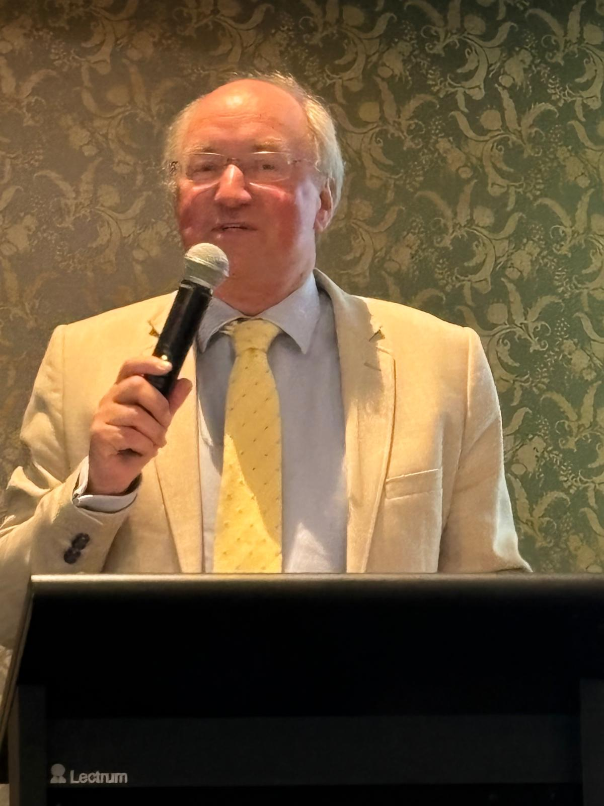
Speaker
Prof David Hodson
OBE KC(Hon) MCIArb
Solicitor (England and Australia), Mediator, Arbitrator, part time Family Court Judge
'David Hodson KC is well regarded for his work in the family law field.’
"He is a go-to for international matters".
"He is so knowledgeable and experienced. He has a fantastic track record. He is a leading family lawyer".’
Chambers HNW UK
‘David Hodson continues in the top league of London family lawyers’
‘What he doesn’t know about international family work isn’t worth knowing’
The Legal 500 UK

Slide 3
Personal introduction and experience
www.infinityfamilylaw.com
David Hodson

Slide 4

What is Christian mentoring?
A relationship in which one person helps another grow in wisdom, character, faith and professional effectiveness.
More than coaching or training: it involves the whole person, not just skills and performance.
More than or not necessarily careers assistance
Rooted in Christian discipleship and service.
A partnership based on trust, confidentiality, encouragement, accountability and prayer.
www.infinityfamilylaw.com
David Hodson

Slide 5
Why mentoring matters in the workplace
Professional life presents ethical, relational, regulatory and leadership challenges.
Many people feel isolated despite working in teams.
Law work is stressful with long hours
Christian mentoring helps individuals integrate faith and work.
Provides a safe space for reflection, discernment and personal growth as well as raising challenging situations
Supports emerging leaders and succession planning.
Sharing knowledge, contacts, realism, experience, opportunities etc with more junior lawyers
www.infinityfamilylaw.com
David Hodson

Slide 6
Biblical foundations
www.infinityfamilylaw.com
David Hodson

Slide 7
Biblical foundations
Jesus and the disciples
Jesus modelled the ultimate mentoring relationship.
He invested deeply in a small group rather than simply teaching crowds.
He taught, demonstrated, observed, corrected and then delegated responsibility.
Example: sending out the disciples to minister and then debriefing with them (Luke 10).
www.infinityfamilylaw.com
David Hodson

Slide 8
Biblical foundations
Paul and Timothy
Perhaps the clearest example of direct one to one mentoring
Paul encouraged, instructed and entrusted responsibility to Timothy.
Combined practical leadership advice with spiritual encouragement.
"What you have heard from me ... entrust to reliable people who will also be qualified to teach others" (2 Timothy 2:2).
www.infinityfamilylaw.com
David Hodson

Slide 9
Biblical foundations
Paul and Titus
Guidance for leadership in a difficult environment
Mentoring included character formation as well as organisational leadership.
Demonstrates the importance of preparing others to lead independently.
These, then, are the things you should teach. Encourage and rebuke with all authority. Do not let anyone despise you – Titus 2:15
www.infinityfamilylaw.com
David Hodson

Slide 10
Biblical foundations
Moses and Joshua
Moses gradually entrusted Joshua with responsibility
Joshua accompanied Moses, observed leadership in action and eventually succeeded him. Obviously parallel with an assistant shadowing in office, at court etc
Shows the importance of succession and long-term development.
www.infinityfamilylaw.com
David Hodson

Slide 11
Biblical foundations
Eli and Samuel
Eli helped Samuel recognise and respond to God's call. 1 Samuel 3
Mentoring includes helping others discern vocation and purpose. A major purpose of more explicit mentoring
www.infinityfamilylaw.com
David Hodson

Slide 12
Biblical foundations
Barnabas and Paul
Barnabas saw potential in Paul when others were wary.
Effective mentors often see gifts in people before they see them themselves.
Barnabas acted as advocate, encourager and connector. Classic role in mentoring in widest sense in a church community
www.infinityfamilylaw.com
David Hodson

Slide 13
Characteristics of a Christian mentor
Humility rather than superiority.
Good listener.
Trustworthy and confidential.
Encouraging and honest.
Willing to ask challenging questions.
Prayerful and discerning.
Focused on serving rather than controlling.
Seeks the mentee's flourishing.
www.infinityfamilylaw.com
David Hodson

Slide 14
Characteristics of a good mentee
Teachable spirit.
Listen
Ask multiple open questions
Openness to feedback.
Willingness to reflect honestly.
Test what is said as to applicable experience
Commitment to growth.
Respect for the mentor's time and experience.
Preparedness to act on agreed goals.
www.infinityfamilylaw.com
David Hodson

Slide 15
Roles of a Christian mentor
Encourager-affirming gifts, strengths and progress.
Guide-sharing experiences and wisdom.
Challenger-asking difficult but constructive questions.
Witness-modelling Christian character in professional life
Example - Follow my example as I follow the example of Christ 1 Corinthians 11.1
www.infinityfamilylaw.com
David Hodson

Slide 16
Distinctive features of Christian mentoring
Recognises mentee as a child of God and share eternity values; helping them to become the person God is calling them to be.
Concerned with character as much as competence and career
Values integrity and Christian faithfulness over success.
Encourages discernment of vocation and calling.
Includes prayer where appropriate and wanted.
Seeks wisdom from Scripture and Christian tradition.
Understands leadership as service.
Discuss distinctive issues in law work
Not expect others to follow one’s own career path or pattern
www.infinityfamilylaw.com
David Hodson

Slide 17
Practical areas for professional mentoring
Career guidance and advancement
Leadership development.
Ethical decision-making.
Career transitions.
Work-life balance.
Managing conflict (clients, employers, courts etc).
Resilience and wellbeing.
Developing younger professionals.
Navigating failure and disappointment.
Discernment about future opportunities.
Coping with stress
www.infinityfamilylaw.com
David Hodson

Slide 18
Coping with stress
Law Society pastoral care helpline 020 7320 5795
Wellbeing at the bar https://www.barcouncil.org.uk/support-for-barristers/wellbeing-personal-career-support/wellbeing-at-the-bar.html
Help available for judges under stress etc: see judicial intranet
A law firm’s private health policy may provide stress help
www.infinityfamilylaw.com
David Hodson

Slide 19
Potential pitfalls
Becoming directive rather than supportive.
Creating dependency; end date as good practice?
Blurring professional and personal boundaries.
Failing to maintain confidentiality.
Assuming one's own career path is the right path for others.
Neglecting safeguarding and accountability.
Too close to a situation – mentees should choose a mentor outside the situation of any conflict or difficulty and with confidence in confidentiality
www.infinityfamilylaw.com
David Hodson

Slide 20
Questions mentors might ask
What is God teaching you through this situation?
What are your strengths and gifts?
What challenges are you currently facing?
What decisions are you avoiding?
How are your values shaping your professional choices, perhaps in cx to others?
What would faithfulness look like in this circumstance?
Who are you helping to develop?
Are you being realistic?
www.infinityfamilylaw.com
David Hodson

Slide 21
The wider vision for the LCF
Professional life presents ethical, relational and leadership challenges.
Christian mentoring is about stewardship of experience and wisdom.
It reflects Christ's pattern of investing in people.
Good mentoring creates a multiplying effect: those mentored often become mentors themselves.
The goal is not simply career success but faithful, effective and Christ-centred service.
Mentoring builds up the body of Christian lawyers as a fellowship to God’s glory
www.infinityfamilylaw.com
David Hodson

Slide 22
Closing thoughts
"Encourage one another and build each other up" (1 Thessalonians 5:11).
Christian mentoring in the legal profession is one practical way of living out that biblical calling—helping others grow in competence, character and calling for the benefit of both the individual, the church and the wider community.
www.infinityfamilylaw.com
David Hodson

Slide 23
Concluding remarks
www.infinityfamilylaw.com
David Hodson

Slide 24
Prof David Hodson
OBE KC(Hon) MCIArb
dh@davidhodson.com
+44 (0) 7973 890648
infinityfamilylaw.com
www.infinityfamilylaw.com
David Hodson

